Slide 1


Drone Based
Parcel Delivery System
Presented by
Subhamay Nath C91/MCA/222026
Subhadeep Sarkar C91/MCA/222025
Guided by:
Mr. Saurav Ghosh
Asst. Prof., AKCSIT, CU

Slide 2

01
Introduction
Necessity of Drone based delivery system
02
Table of Contents
03
Challenges in Drone Based Delivery System.
04
Our Work & Analysis .

Slide 3
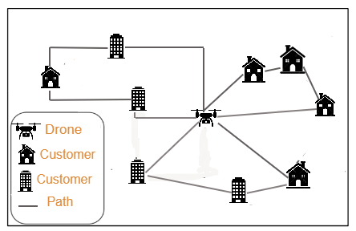
Introduction
Optimizing drone delivery routes in environments with both Euclidean and Manhattan characteristics.
Identify optimal distribution points (DPs) and paths to minimize travel distance while considering obstacle avoidance and regional constraints.
.

Slide 4
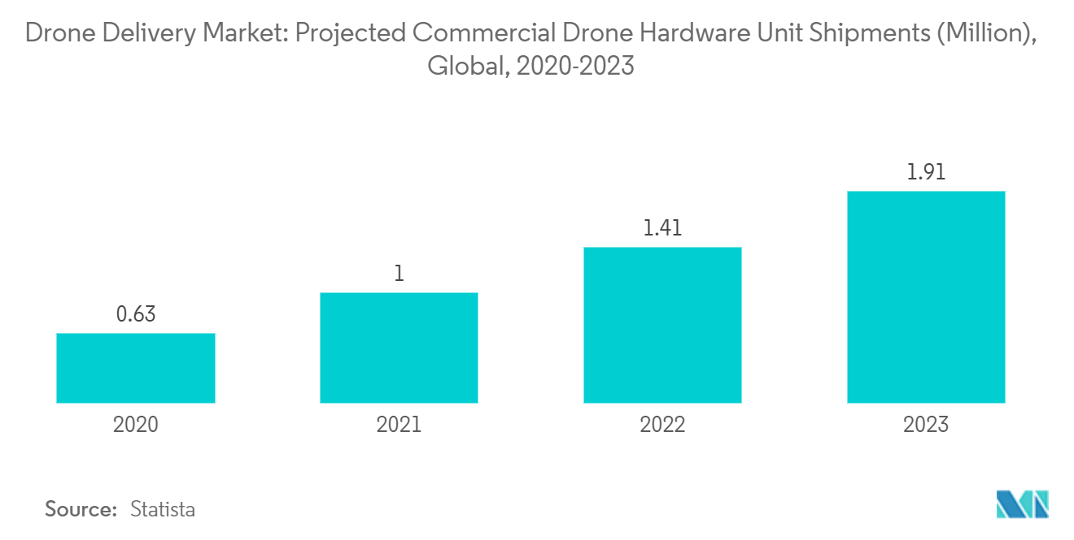
Not an Imagination Anymore
Drone Delivery Market Size & Share Analysis - Growth Trends & Forecasts (2024 - 2029) Source: https://www.mordorintelligence.com/industry-reports/delivery-drones-market

Slide 5
Necessity of Drone based Delivery system
Remote Access: Provides access to remote and inaccessible areas[4].
Traffic Congestion Relief: Mitigates delays caused by traffic congestion.
Delivery Speed: Ensures rapid delivery of parcels to customers.
4. Eskandaripour, H., & Boldsaikhan, E. Last-Mile Drone Delivery: Past, Present, and Future (2023), Source: https://www.mdpi.com/2504-446X/7/2/77

Slide 6
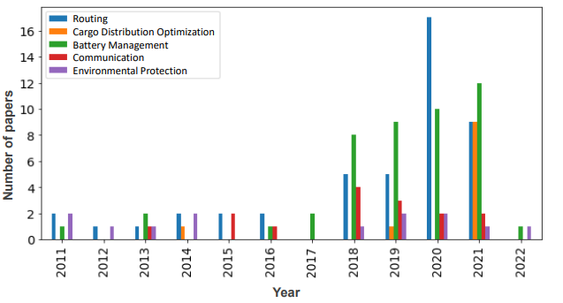
Challenges in Drone Based Delivery System

Slide 7
Challenges in Drone Based Delivery System
Drone Capacity: Balancing the carrying capacity of drones with operational efficiency.
Battery Capacity: Managing limited battery life to extend flight times and operational range.
Cost Optimization: Ensuring cost-effective routing paths for drone deliveries.
Obstacle Avoidance: Implementing effective obstacle avoidance mechanisms for safe operations.

Slide 8
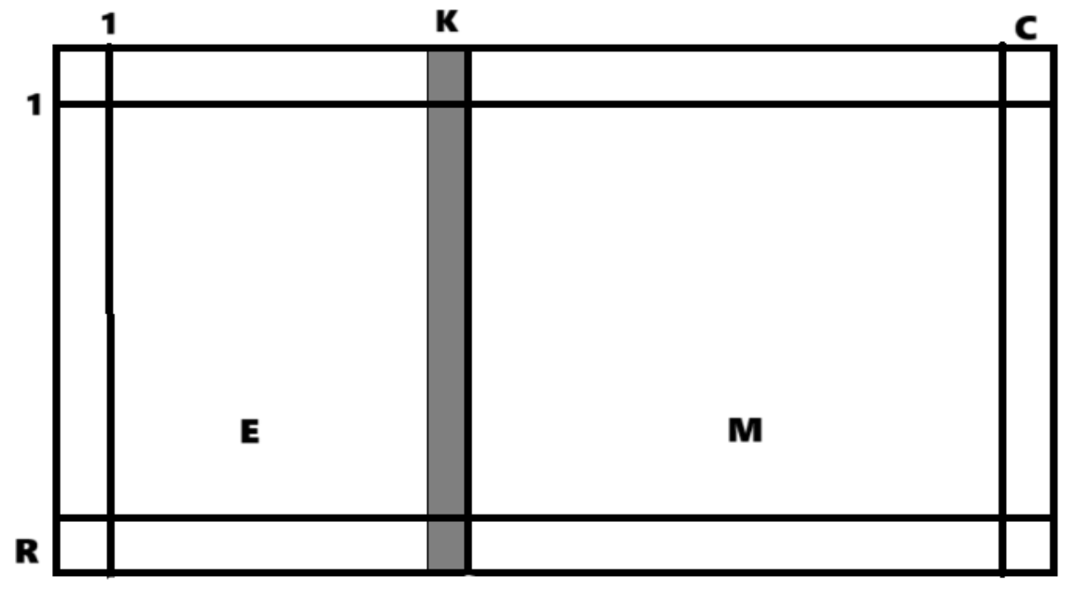
Pre Assumptions
Euclidean Region (E)
Rural region, drone can navigate freely
Manhattan Region (M)
Urban region, drone can navigate through only horizontal or vertical axis
EM-Grid
Hybrid region i.e. a combination of both and separated by a linear border (K)
Bluesky Simulator
A python simulator to simulate drone based delivery
EM-GRID

Slide 9
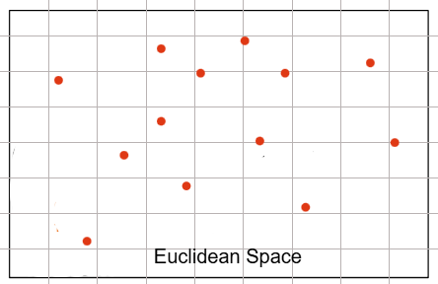
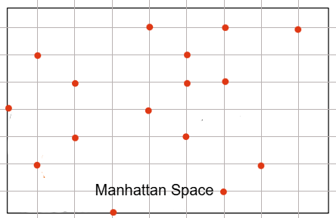
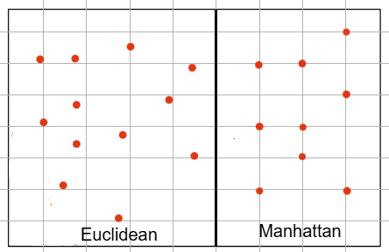
Pre Assumptions
Euclidean region
Manhattan region
Hybrid Region consisting of both Euclidean and Manhattan

Slide 10

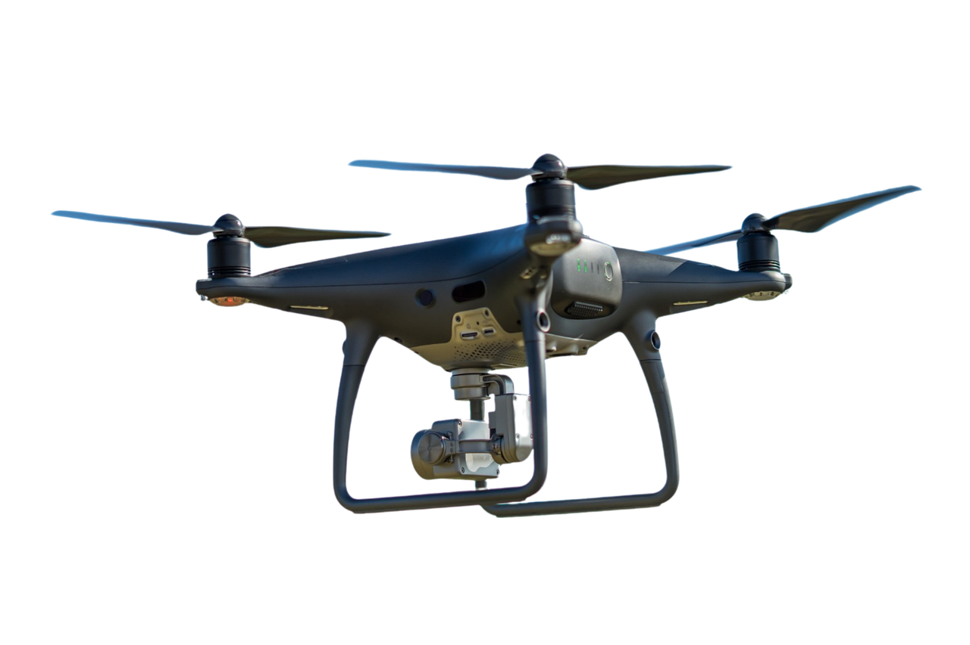

Our Work & Analysis
Our implementation successfully addresses a critical challenge in drone delivery systems: routing optimization[1].
We can effectively find a DP (Distribution Point) that minimizes the overall routing distance of the drone, thereby enhancing efficiency and reducing operational costs
The Distribution Point, often denoted as DP, serves as the central hub for drone-based parcel delivery, strategically located for optimizing the overall travel distance.
F. Betti Sorbelli, C. M. Pinotti and G. Rigoni, ”On the Evaluation of a Drone-Based Delivery System on a Mixed Euclidean-Manhattan Grid,” in IEEE Transactions on Intelligent Transportation Systems, vol. 24, no. 1, pp. 1276-1287, Jan. 2023

Slide 11
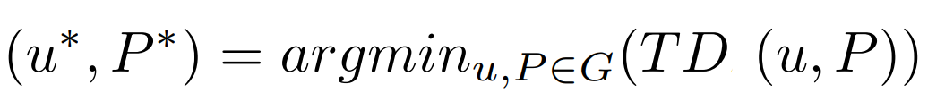
Problem Statement
Our objective is to determine an efficient distribution point u(a,b) and routing path P for each of the scenarios.
This will enable a drone to visit all N delivery points where N_{i} (x_{i}, y_{i}) while minimizing the total travel distance.

Slide 12
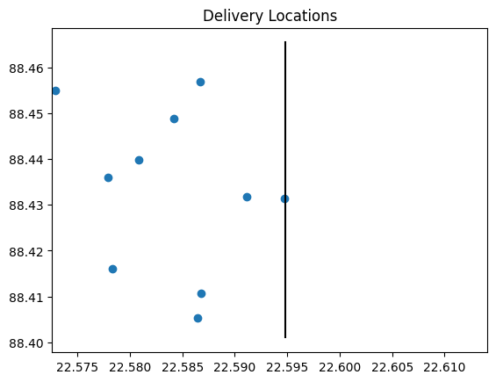
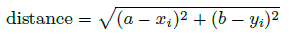
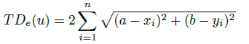
01
Scenario 1: Euclidean Region (Single Capacity Drone)
Euclidean metric for direct, straight-line
Distances Formula:
Total Distance:

Slide 13
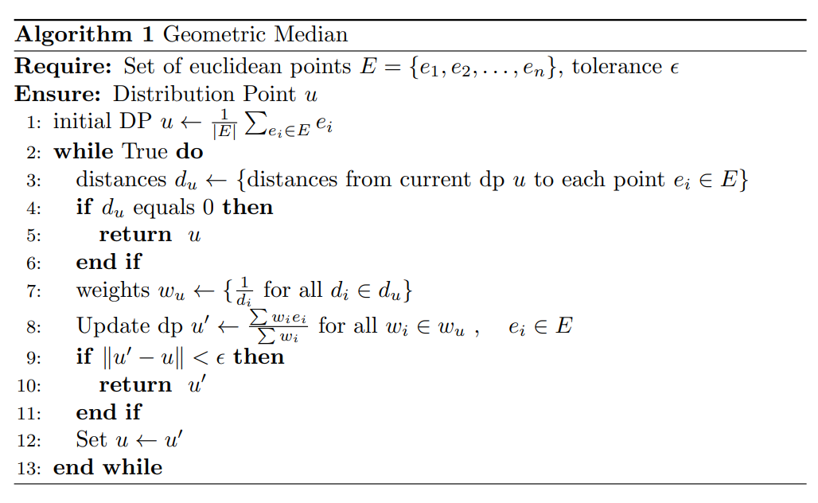
Proposed Approach
Calculate Mean as initial DP
Update DP with the geometric mean w.r.t previous DP
Until distance change is very negligible
Return DP

Slide 14
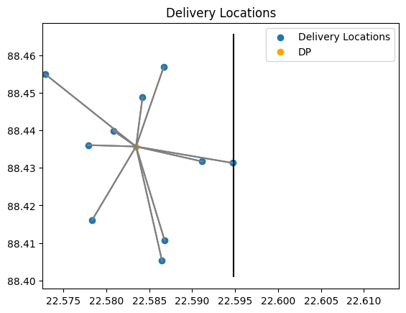
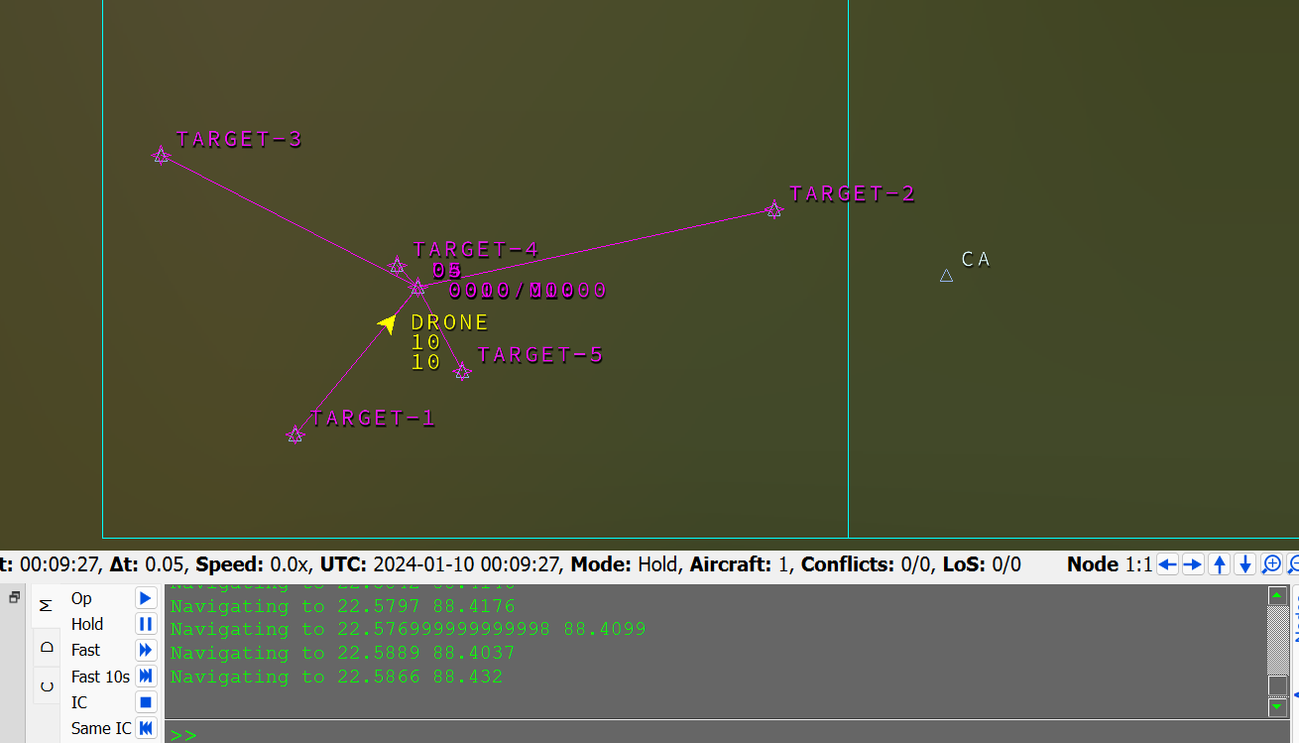
Output
Placement of DP using Geometric Median Approach
BlueSky Output

Slide 15
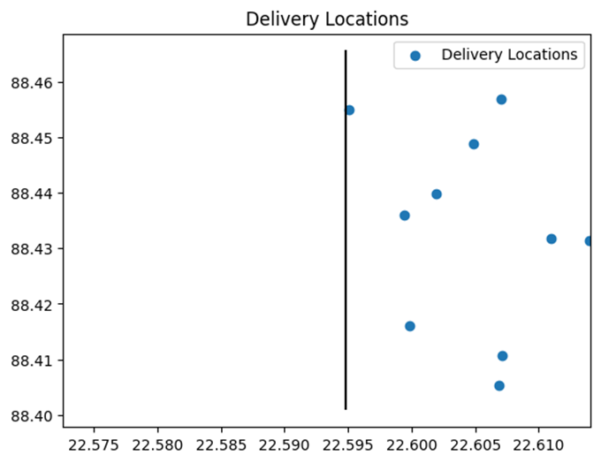
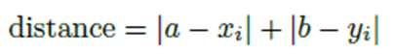
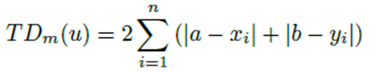
02
Scenario 2: Manhattan Region (Single Capacity Drone)
Manhattan metric for direct, straight-line
Distances Formula:
Total Distance:

Slide 16
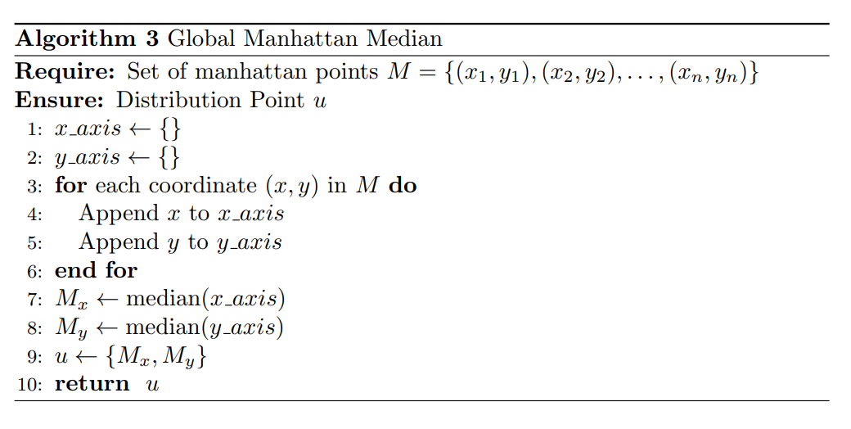
Proposed Approach
Create 2 separate set for x and y axis
Calculate median for both sets
DP = (Median of x set, Median of y set)
Return DP

Slide 17
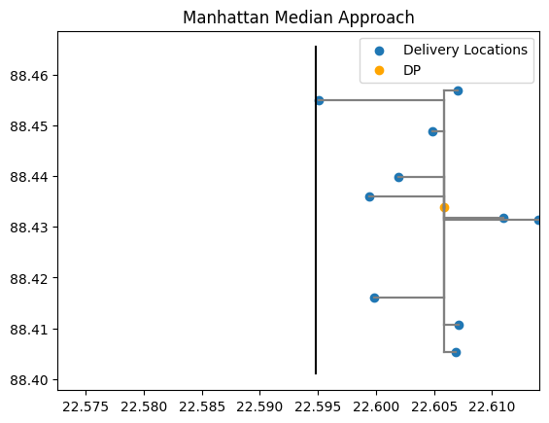
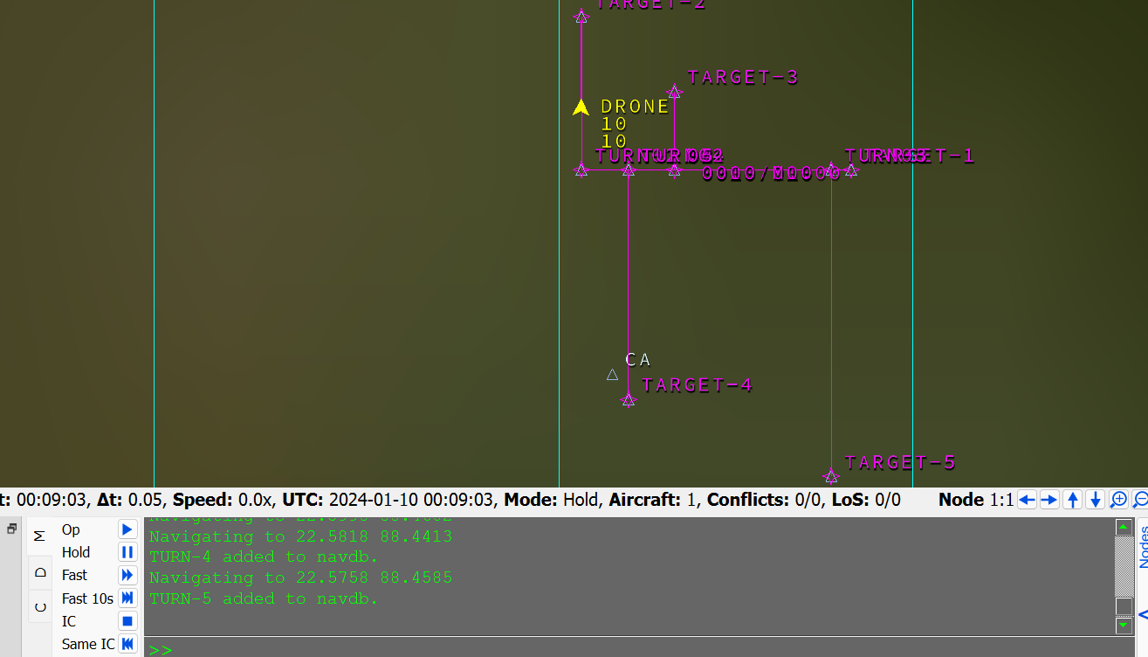
Output
Placement of DP using Manhattan Median Approach
BlueSky Output

Slide 18
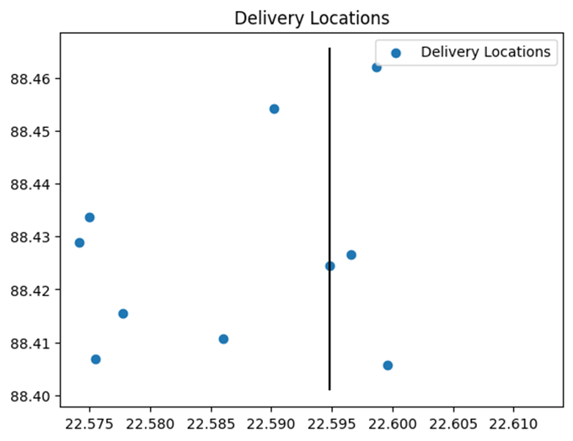
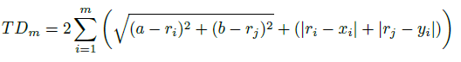
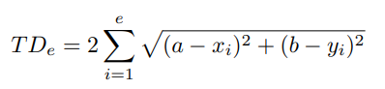
03
Scenario 3: Hybrid Region(DP in Euclidean)
Distance Calculation(Euclidean):
Distance Calculation(Manhattan):
Total Distance:

Slide 19
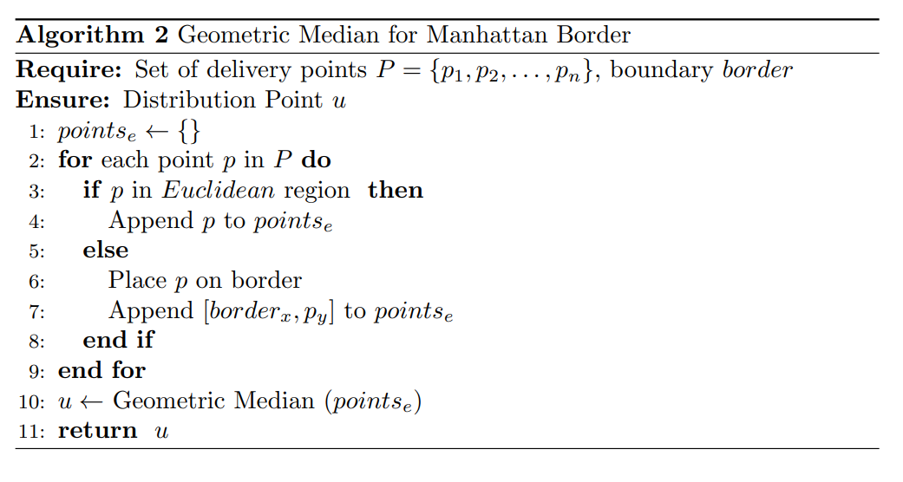
Proposed Approach
Place Manhattan points on the border
Keep Euclidean points as it is
Apply Geometric Median on the new coordinates
Return DP

Slide 20
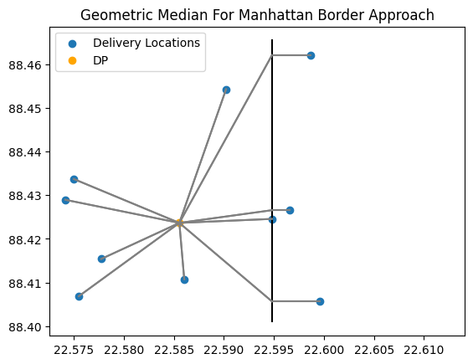
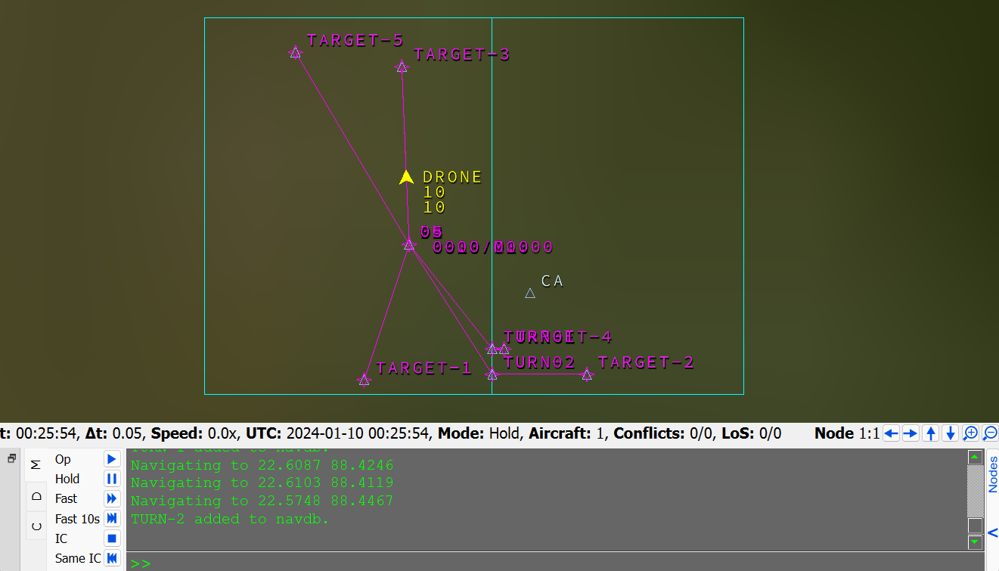
Output
Placement of DP using Geometric Median Approach
BlueSky Output

Slide 21
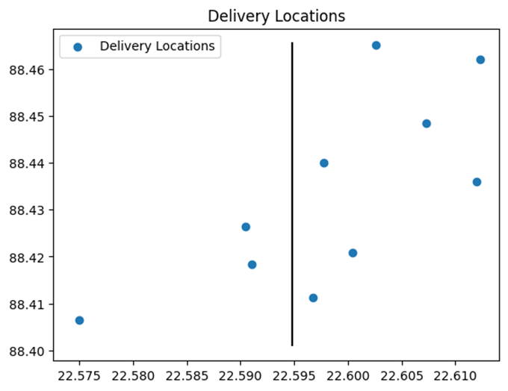
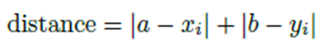
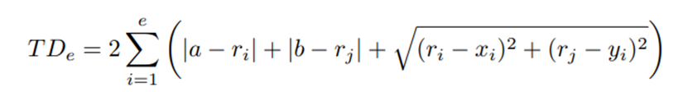
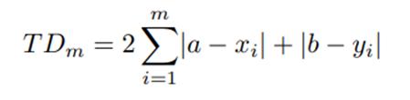
04
Scenario 4: Hybrid Region(DP in Manhattan)
Distance Calculation(Euclidean):
Distance Calculation(Manhattan):
Total Distance:

Slide 22
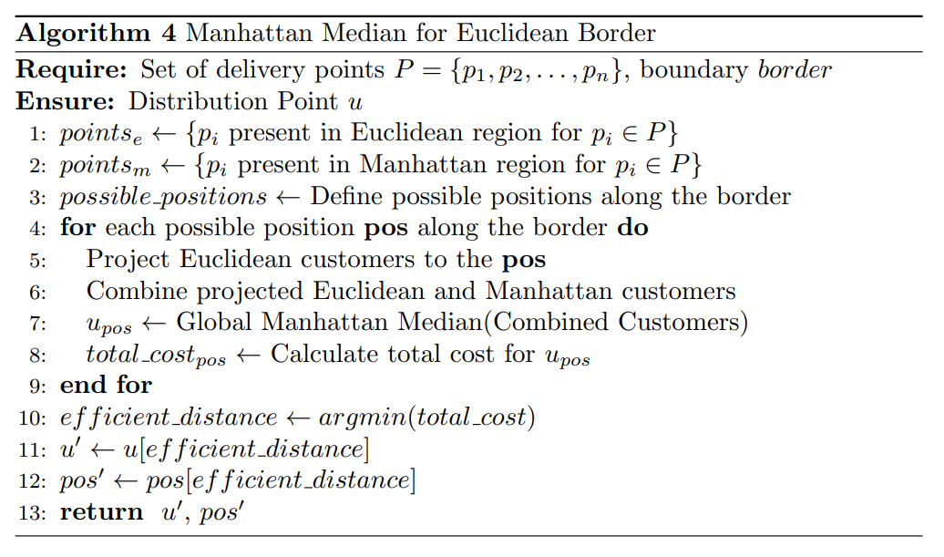
Proposed Approach
Divide border in different intervals on Y axis
Place Euclidean points on that interval
Apply Geometric Median on new coordinates
Return DP that generates minimum distance

Slide 23
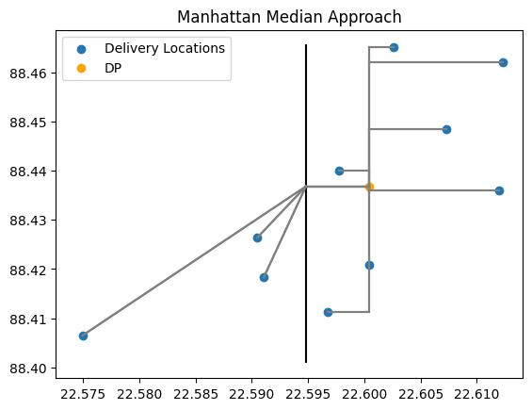
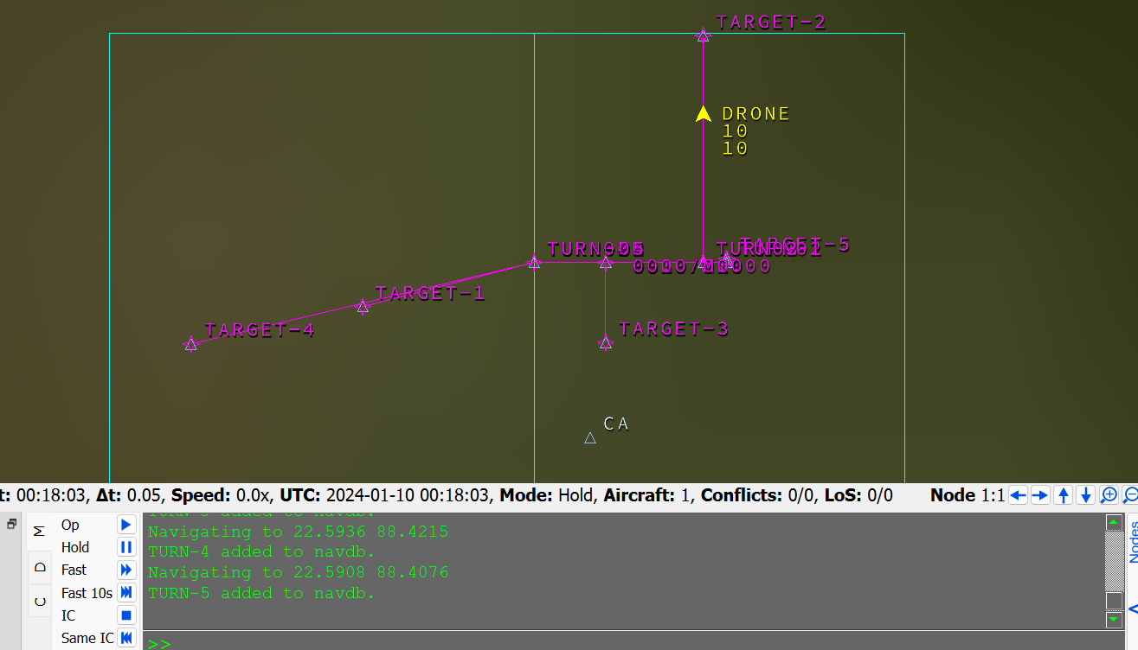
Output
Placement of DP using Manhattan Median Approach
BlueSky Output

Slide 24
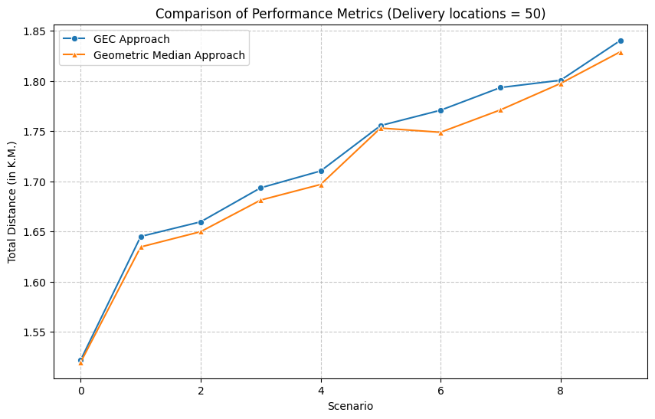
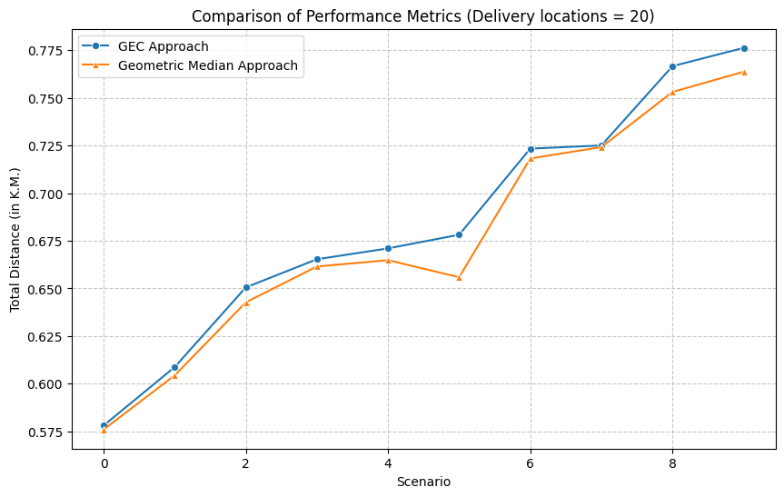
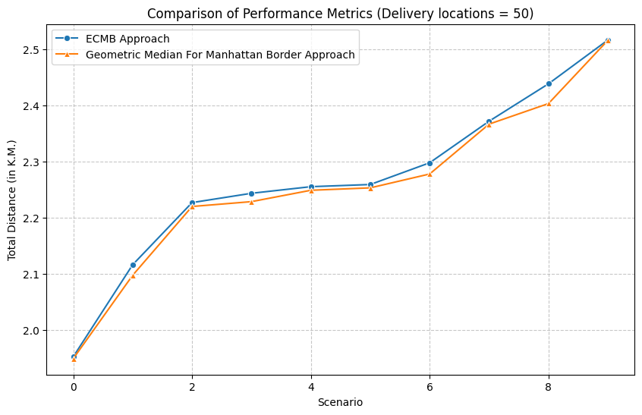
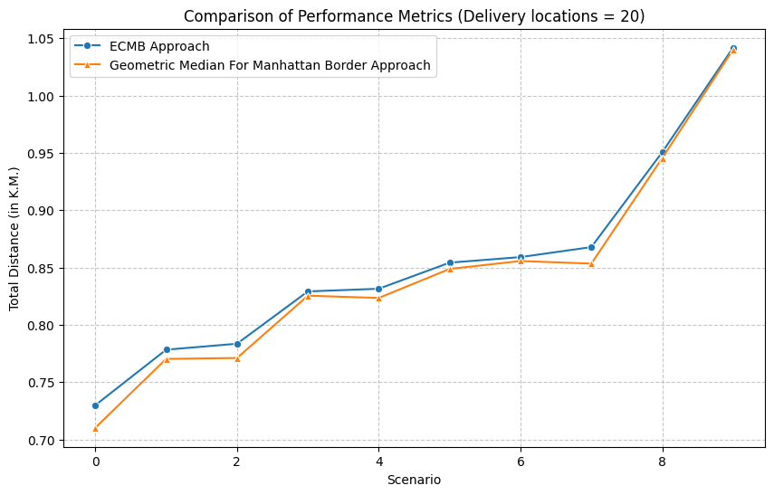
Result and Analysis

Slide 25
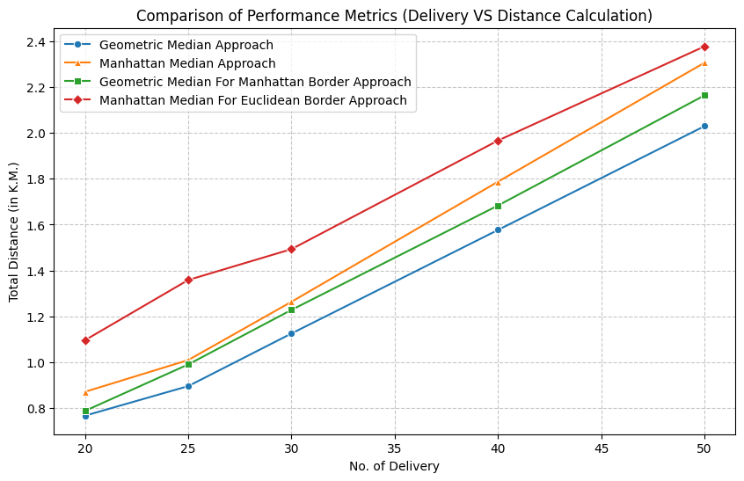
Delivery VS Distance Comparison

Slide 26
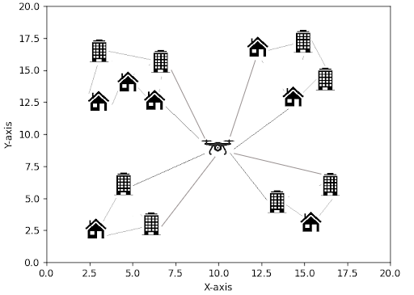
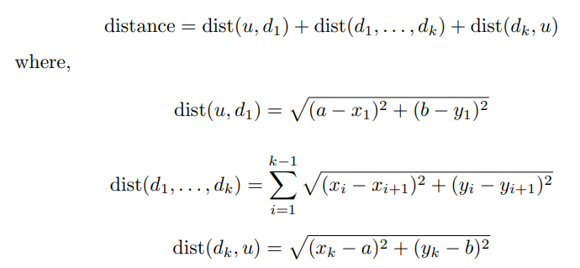
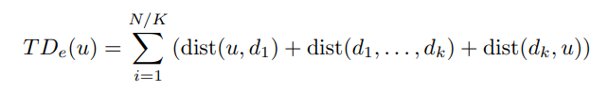
05
Scenario 5: Euclidean Region with Drone Capacity K
Distance covered by drone in one cycle:
Total Distance:

Slide 27
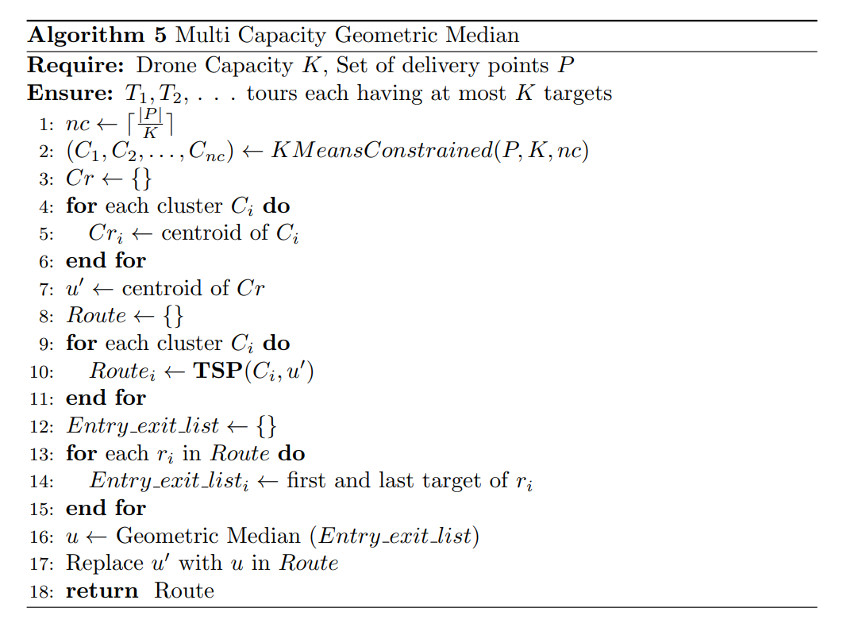
Proposed Approach
Construct P/K Clusters
Create initial DP by mean of cluster centroids
Construct TSP w.r.t Cluster points and initial DP
Update DP by Geometric Median

Slide 28
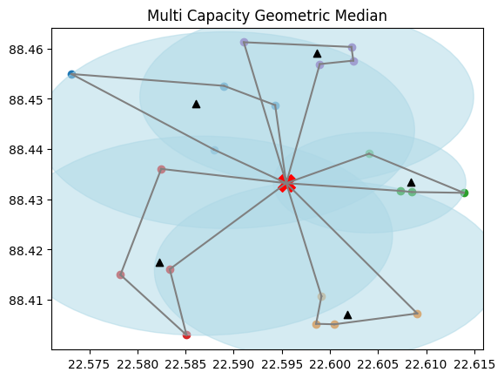
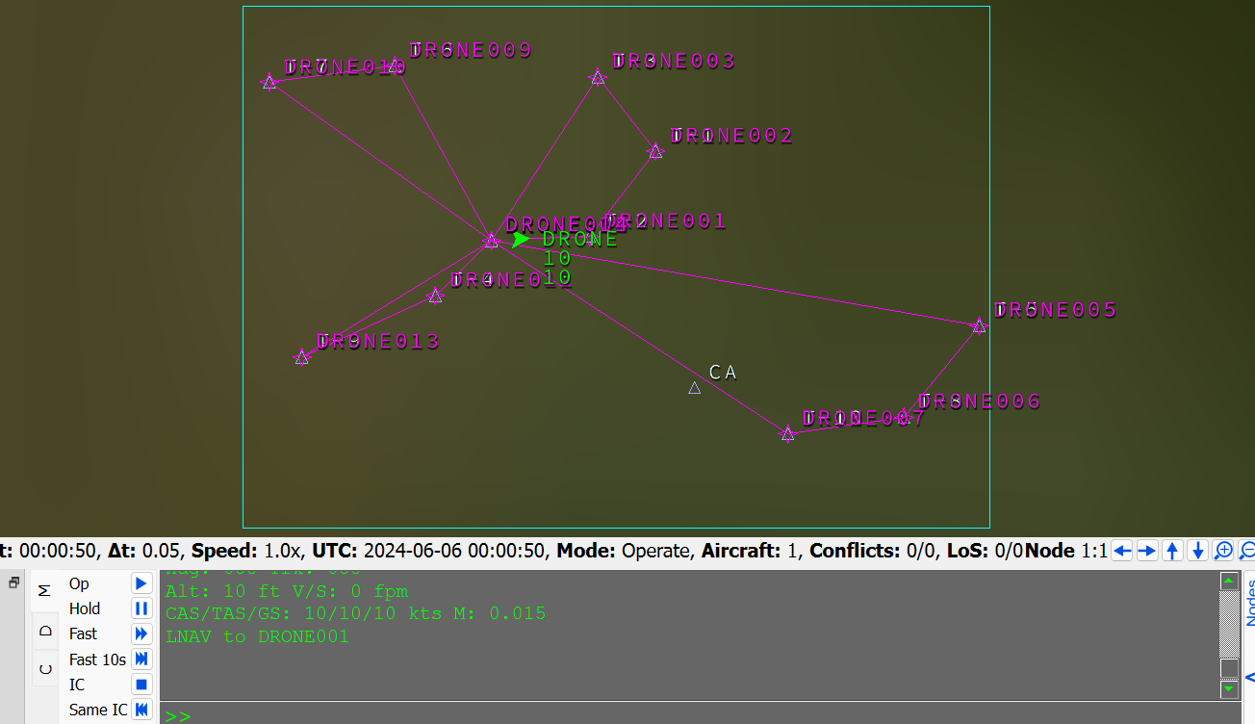
Output
Placement of DP using Geometric Median Approach
BlueSky Output

Slide 29
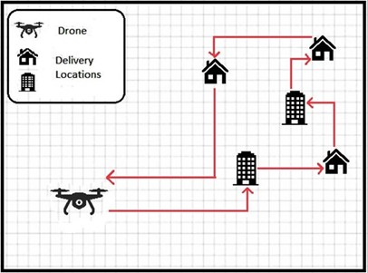
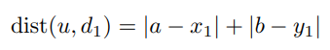
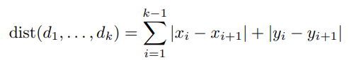
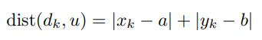
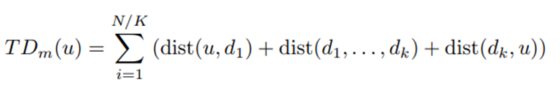
06
Scenario 6: Manhattan Region with Drone Capacity K
Distance covered by drone in one cycle:
Where,
Total Distance:

Slide 30

Proposed Approach
Construct P/K Clusters
Create initial DP by Manhattan Median of cluster centroids
Construct TSP w.r.t Cluster points and initial DP
Update DP by Manhattan Median

Slide 31


Output
Placement of DP using Manhattan Median Approach
BlueSky Output

Slide 32




07
Scenario 7: Hybrid Region with Drone Capacity K
Distance covered by drone in one cycle:
Where,
for Manhattan,
for Euclidean,
Total Distance:

Slide 33

Proposed Approach
Construct Clusters for both Euclidean and Manhattan Region
Create two DP
Construct TSP w.r.t Cluster points and current DP
Select DP with minimum distance

Slide 34


Output
Placement of DP using Geometric Median Approach
Placement of DP using Manhattan Median Approach

Slide 35


Result and Analysis
Drone performance w.r.t Delivery & Distance
Drone performance w.r.t Capacity & Distance

Slide 36



08
Scenario 8: Single Capacity Drone Amidst Obstacles
Distance covered by drone in one cycle:
Total Distance:

Slide 37

Proposed Approach
Calculate Mean as Initial DP
Create a Graph with Obstacles, Delivery Locations, and DP
Apply Single-Source Dijkstra Algorithm
Update DP with Geometric Mean Relative to Previous DP

Slide 38


Graph Formation
Graph Creation
Applying Dijkstra Algorithm

Slide 39


Output
Single Capacity Path Finding Algorithm
BlueSky Output

Slide 40



09
Scenario 9: Drone with Capacity K navigating through obstacles
Distance covered by drone in one cycle:
Where,
Total Distance:

Slide 41

Proposed Approach
Construct P/K Clusters
Create initial DP by mean of cluster centroids
Create Graphs Incorporating delivery locations, Obstacles and DP
Compute Distance Matrix for Each Cluster using Dijkstra Algorithm
Apply TSPs to Each Cluster
Optimize DP Locations Using Geometric Median

Slide 42


Output
Multiple Capacity Path Finding Algorithm
BlueSky Output

Slide 43

Result and Analysis

Slide 44


Result and Analysis
Performance of Single Capacity Path Finding Algorithm
Performance of Multi Capacity Path Finding Algorithm

Slide 45

Conclusion
Addressing the problem of finding cost-optimal paths for drones amidst obstacles is crucial for enhancing delivery efficiency
By considering both single and multiple capacity drone scenarios, our approach offers scalable solutions
The challenge of determining the optimal distribution point (DP) location, which minimizes drone movement, was addressed through innovative algorithms such as Geometric Median

Slide 46
Future Goals
Include the scenario where the border will be non linear
Include AI for obstacle detection and change routing direction
Create 3D mapping and pathfinding algorithms to efficiently navigate around vertical and horizontal obstacles.

Slide 47
References
F. Betti Sorbelli, C. M. Pinotti and G. Rigoni, ”On the Evaluation of a Drone-Based Delivery System on a Mixed Euclidean-Manhattan Grid,” in IEEE Transactions on Intelligent Transportation Systems, vol. 24, no. 1, pp. 1276-1287, Jan. 2023
L. Bartoli, F. B. Sorbelli, F. Coro, C. M. Pinotti, and A. Shende, “Exact and approximate drone warehouse for a mixed landscape delivery system,” in Proc. IEEE Int. Conf. Smart Comput. (SMARTCOMP), Jun. 2019, pp. 266–273.
Alyassi, R.; Khonji, M.; Karapetyan, A.; Chau, S.C.-K.; Elbassioni, K.; Tseng, C.- M. Autonomous recharging and flight mission planning for battery-operated autonomous drones. IEEE Trans. Autom. Sci. Eng. 2022.
Eskandaripour, H., & Boldsaikhan, E. Last-Mile Drone Delivery: Past, Present, and Future (2023), Source: https://www.mdpi.com/2504-446X/7/2/77
Drone Delivery Market Size & Share Analysis - Growth Trends & Forecasts (2024 - 2029) Source: https://www.mordorintelligence.com/industry-reports/delivery-drones-market

